Slide 1
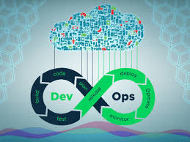



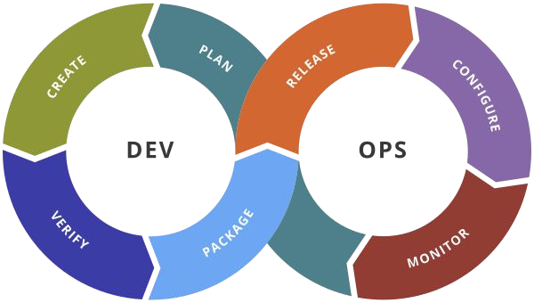
MYSURU ROYAL INSTITUTE OF TECHNOLOGY (Affiliated to VTU, Belagavi, Approved by AICTE, New Delhi & Govt. of Karnataka) Lakshmipura Road, Off-Mysuru-Bengaluru Highway, Srirangapatna
DEPARTMENT OF COMPUTER SCIENCE AND ENGINEERING
Seminar Presentation on
DevOps - The Future of Technology
Presented By,
Prajwal H S (4MU16CS088)
8th Sem,CSE
Under the Supervision Of
Sowmya B J
Seminar Guide
Dept of CSE,MRIT
Internal Guide
Sowmya B
Asst.Professor & HOD
Dept of CSE, MRIT

Slide 2
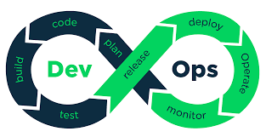
Contents
Abstract
Introduction to DevOps Concept & Technology
- Overview
- Objectives & Goals
DevOps Evolution
Literature Survey and Key concepts
System Architecture
Future Scope,Applications & Limitations
Conclusion
References

Slide 3
Abstract
DevOps is the portmanteau of development and operations. In recent times, the agile transformation was adopted in IT organizations for continuous integration principles in SDLC which has improved the efficiency of development in the project.
Development to Operations (DevOps) will have a profound impact on the global IT sector in the near future.However, with the growth in product choices, conflicting definitions and competing services, customers often encounter confusion, while making complex purchase decisions.
Many organizations which develop and use Information Systems make a structural division of their software departments.
Lately, there has been discussion about whether this division is warranted. This discussion centers around a concept called DevOps, which has thus far not been frequently discussed in academic literature.
DevOps is the new development that addresses such inefficiencies. It connects development, quality assurance, and technical operations personnel in a way that the entire ‘build-release-run-repeat’ process operates as a factory, having clear roles and responsibilities and well-defined inputs and outputs.

Slide 4
Introduction to DevOps
Devops is a new trend which has emerged from collision between two old trends namely ‘agile system administrations’ or ‘agile operations’ and other is the understanding the value of collaboration between development and operation staff in each and every stages of DevOps life cycle.
‘Dev’ means all the developers involved in production stage. ‘Ops’ means the term used for system engineers, system administrators, security professionals and various other disciplines or job title.
Many IT projects run inefficiently, missing implementation deadlines and causing outages during or after implementation and therefore, costing significantly more than anticipated.
DevOps is the new development that addresses such inefficiencies.
In simple terms, DevOps refers to an umbrella concept that encompasses people, processes, and technologies required to connect development to execution.

Slide 5
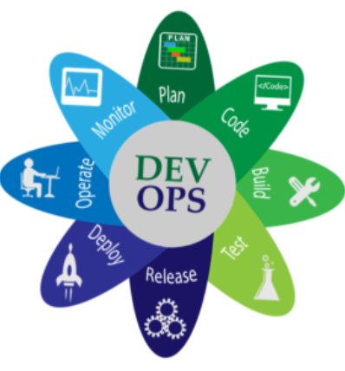
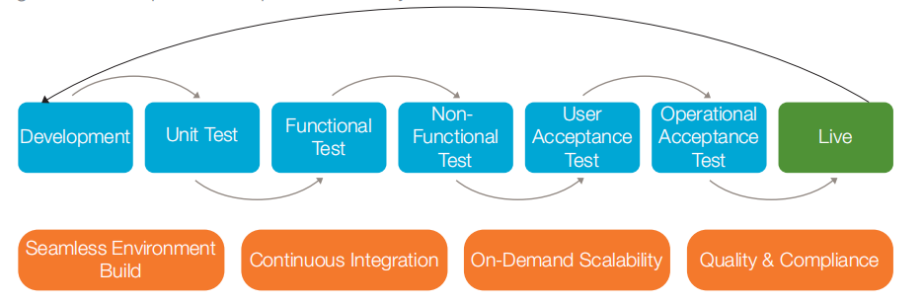
What is DevOps?
In simple words the DevOps means ‘It is a combination of software development and operations’.
It came to emphasize the communication, collaboration, and cohesion between the traditionally separated development and IT operations teams.
DevOps helps an organization deploy software more frequently, while maintaining service stability and gaining the speed necessary for more innovation.
DevOps Life Cycle

Slide 6
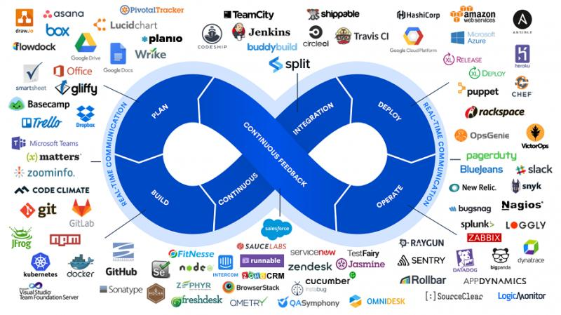

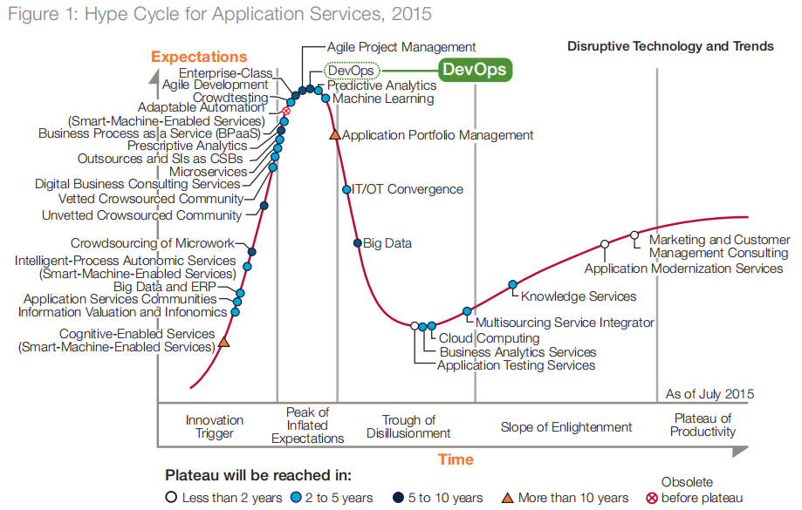
DevOps Trend
DevOps Trend Analysis Using Hyper Cycle for Applicatopn Services

Slide 7
Objectives
The aim of DevOps is to revolutionize the transition, de-risk IT deployments, eliminate the excuse “but-it-works-on-my-system”, and break the silos between developers, testers, release managers, and system operators.
The products and tools developed in this area focus on maximizing predictability, visibility, and flexibility, while maintaining stability and integrity.
DevOps has fundamentally changed the way an IT organization works and how it gets things done. Since its inception in 2009, DevOps (coined as the “new Cloud” by market) has been adopted at a rapid pace.
According to IDC’s “DevOps and the Cost of Downtime: Fortune 1000 Best Practice Metrics Quantified”
• The average hourly cost of an infrastructure failure is $100,000
• The average hourly cost of a critical application failure is $500,000 – $1M
• The average number of deployments per month is expected to double in 2 years
• Unplanned application downtime costs the Fortune 1000 from $1.25 billion to $2.5 billion every year.

Slide 8
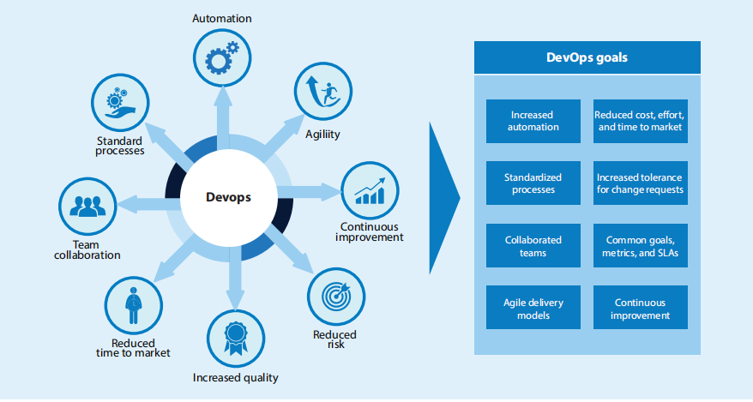
Goals
The goal of DevOps is not to eliminate errors/downtime, rather automate manual tasks and create repeatable processes with greater transparency & traceability.
By this process, Devops help organizations attain a stable and reliable IT infrastructure.
1. Strong collaboration between development and operation teams.
2. Synchronized deployment across multiple platforms.
3. Pressure to release applications to meet customer requirements or to enter into the new market.
4. Improving end user capability levels.
5. Vast usage of smart devices
6. Necessity to develop and deploy into cloud-based
applications.
7. Increasingly complex IT infrastructure.
8. Need to reduce the cost for IT industry.

Slide 9


Significance : Recognizing Business values
Dev
Ops
DevOps applies agile and lean principles in the complete software deployment process to enhance the speed of delivery of product or service
DevOps return our investment in these three areas,
1. Enhanced Customer Experience
Delivering an enhanced product for the customer leads to build loyalty and increase in market share.
2. Increased capacity to Innovate
Lean thinking approaches are used in modern organizations to increase their innovation capacity. Their goals are to utilize the resources efficiently for other activities by reducing waste and rework.
3. Faster time to value
This involves in development of new culture and practices and automating the project leads to fast and reliable delivery process throughout the production phase.

Slide 10
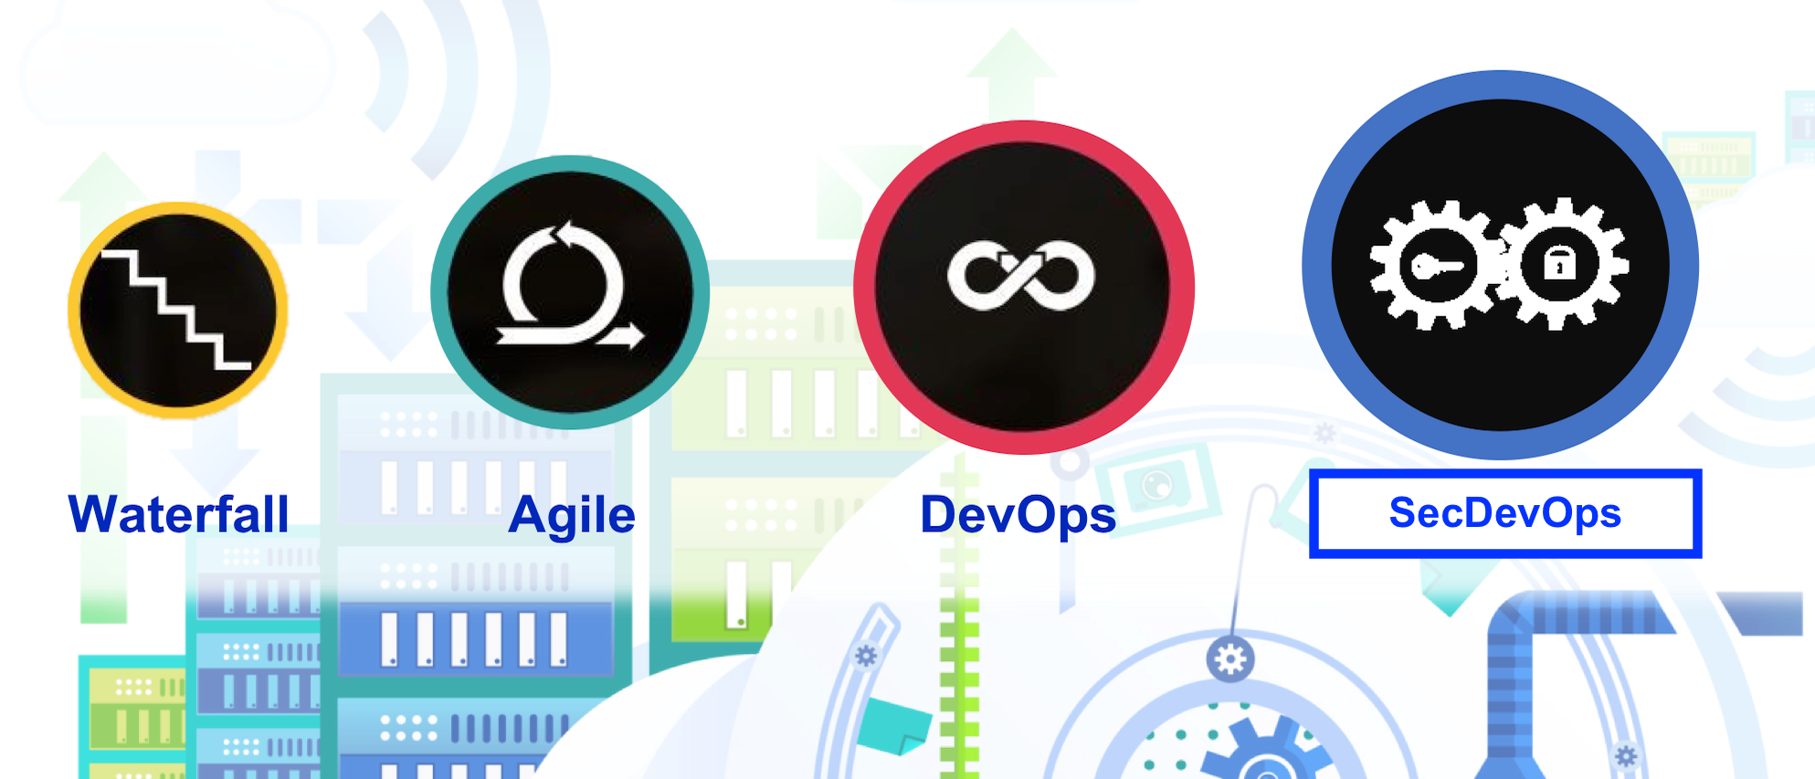
Evolution
Patrick Debois, who devised the name “DevOps” in 2009 and he is also called as “The Father of DevOps” devised the name “DevOps” in 2009.
The word DevOps says itself that it formed by coalescing the two words “Development” and “Operations”.
This is the time to change the old technology to new technology like DevOps. - “Time to stop wasting money, time to start delivering great software and building systems that scale and last” – Patrick Debois.
The most important ones will always be the following: writing features,testing the code, finding flaws (debugging), and deployment of those features to production.
Each of these stages involves a certain team of specialists: developers write code, Quality Assurance (QA) engineers are responsible for testing while system administrators deploy stuff.
The early adopters or the “DevOps Unicorns” like Netflix, Amazon, Google, Etsy, and Snapchat have continuously innovated and showcased successful DevOps model variants like NoOps, ChatOps, and SmartOps.
Over the next 5 years, the DevOps market looks very positive, with many sources forecasting double-digit growth and a higher adoption rate as larger enterprises begin to understand the benefits DevOps can bring in terms of cost reduction and agility.

Slide 11
History
If DevOps had a birth certificate, the father’s name would be penned in as Patrick Debois. Patrick was interested in learning IT from every perspective, and in 2007.
Later, in 2008 during an Agile conference held in Toronto, Canada, a man by the name of Andrew Shafer tried to put together a meetup session entitled “Agile Infrastructure.”
Initially, the interest was pretty tame and not a whole lot came of it. In June of 2009, John Allspaw and Paul Hammond gave a talk entitled “10+ Deploys a Day: Dev and Ops Cooperation at Flickr.”
He named the event DevOpsDays, occurring in the last days of October in 2009.
Finally, in March of 2011, Cameron Haight of Gartner presented his predictions for the trajectory of DevOps over the next few years.
In a recent study, Rackspace interviewed 700 IT decision makers and found 55% of the organizations had already implemented or adopted DevOps and are looking for enhancements. Further 31% of them plan to use DevOps in the next 2 years.

Slide 12
Key Concepts and Literature Survey
The principles of DevOps are Iterative, Incremental, Collaboration, Quantification, automation, integration and Holistic . Lets discuss below few of the key features of DevOps.
In short, the main principles of DevOps are automation, continuous delivery, and fast reaction to feedback. You can find a more detailed explanation of DevOps pillars in the CAMS acronym:
Culture represented by human communication, technical processes, and tools
Automation of processes
Measurement of KPIs.
This paper deals with a systematic literature review which focus on the general term DevOps. The literature review includes all relevant literature which doesn't rely only on one research methodology, one set of journals, or one geographic region.
The search is processed in IEEE Xplore, ACM Digital Library and EBSCO Information Services.
DevOps is an evolution of the agile movement [8]. Agile Software Development advocates small release iterations with customer reviews.
Theoretically, this structure provides higher stability for software in production. However, in practice.

Slide 13
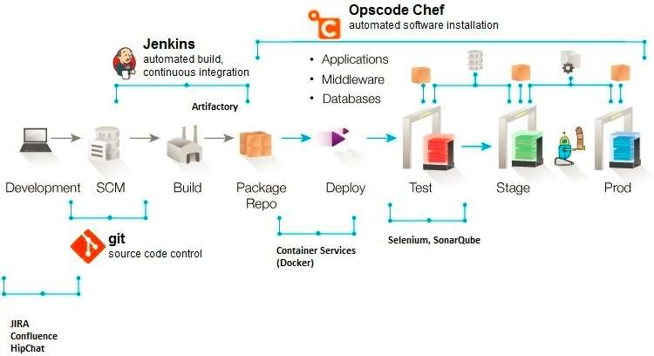
Devops Architecture
The proposed system architecture contains the three phases known as DEV, STG and PRD.
These three phases are explained here with some of the tools required to work in these phases.

Slide 14
Devops Architecture
While designing DevOps Architecture the below points to be considered…
Designers must thoroughly understand customer use cases:
Usability, reliability, scaling, availability, testability and supportability are more important than individual features! Quality over quantity is recommended.
Designs that anticipate actual customer usage are the most successful.
The culture needs to support designers:
Leaders must support the designers with motivation, mentoring and training. No designer can be expected to know everything. It’s OK for designers to make some mistakes if lessons are learned and improvement quickly follows. Good DevOps practices including continuous monitoring and quick remediation are examples of practices which help minimize the impact of any mistakes.
Supporting tools are needed to realize Design for DevOps practices:
Elastic infrastructures that can be easily orchestrated, created and released as needed to support designers tasks on-demand with minimal delay.
Design, code management, monitoring and test tools readily available and scalable with minimal delay.
Monitoring tools that track application process performance and report the results to designers in easily consumable formats without delay.

Slide 15
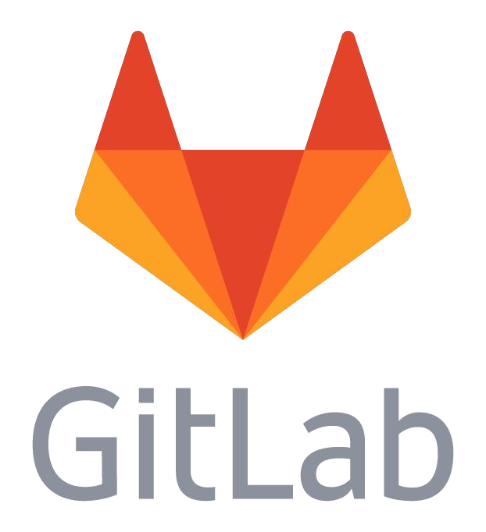



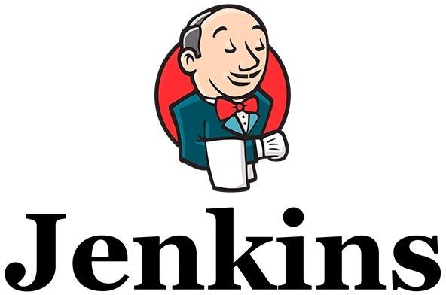
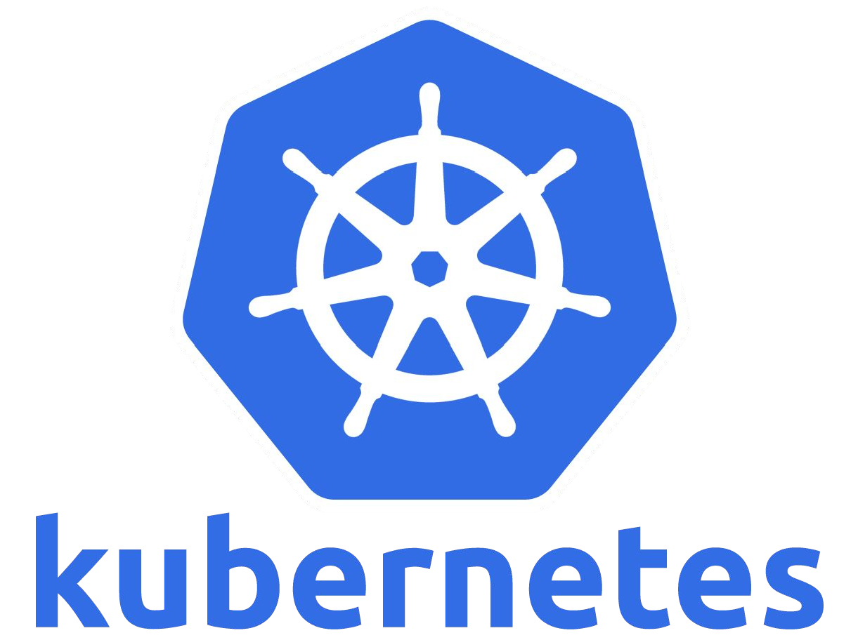
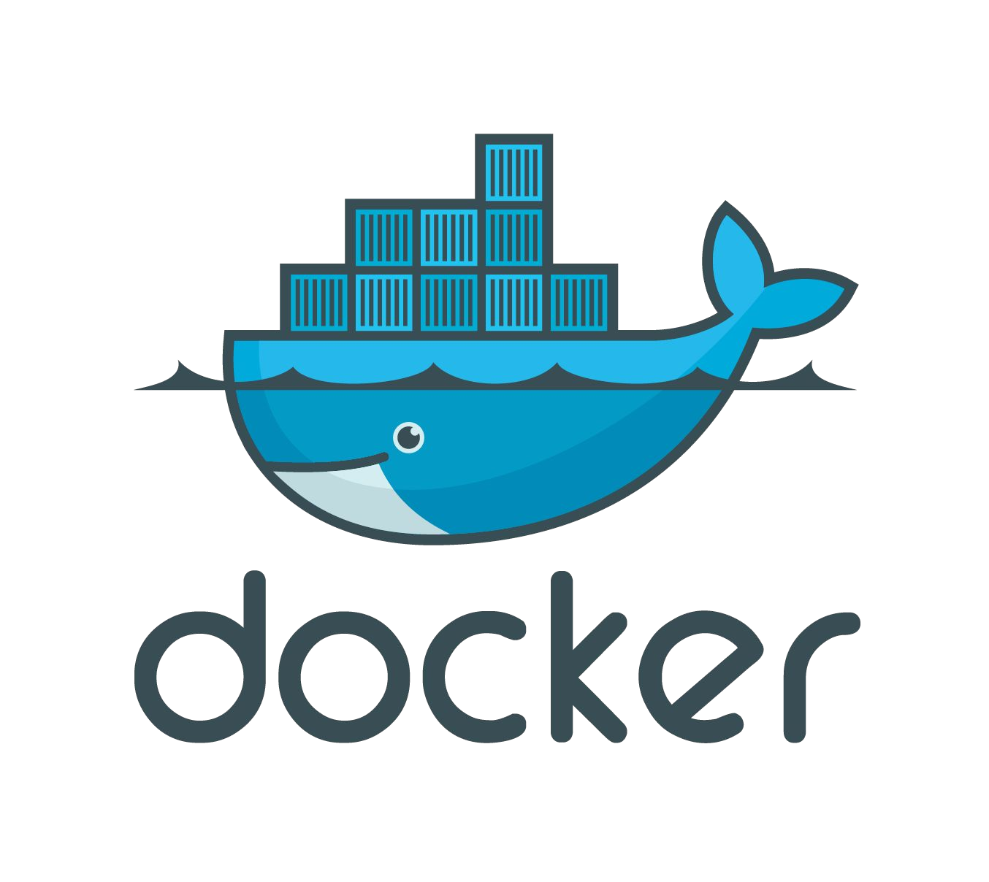


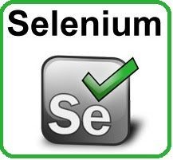


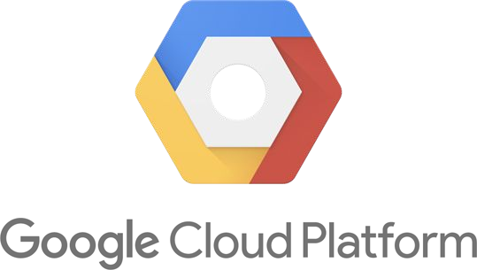
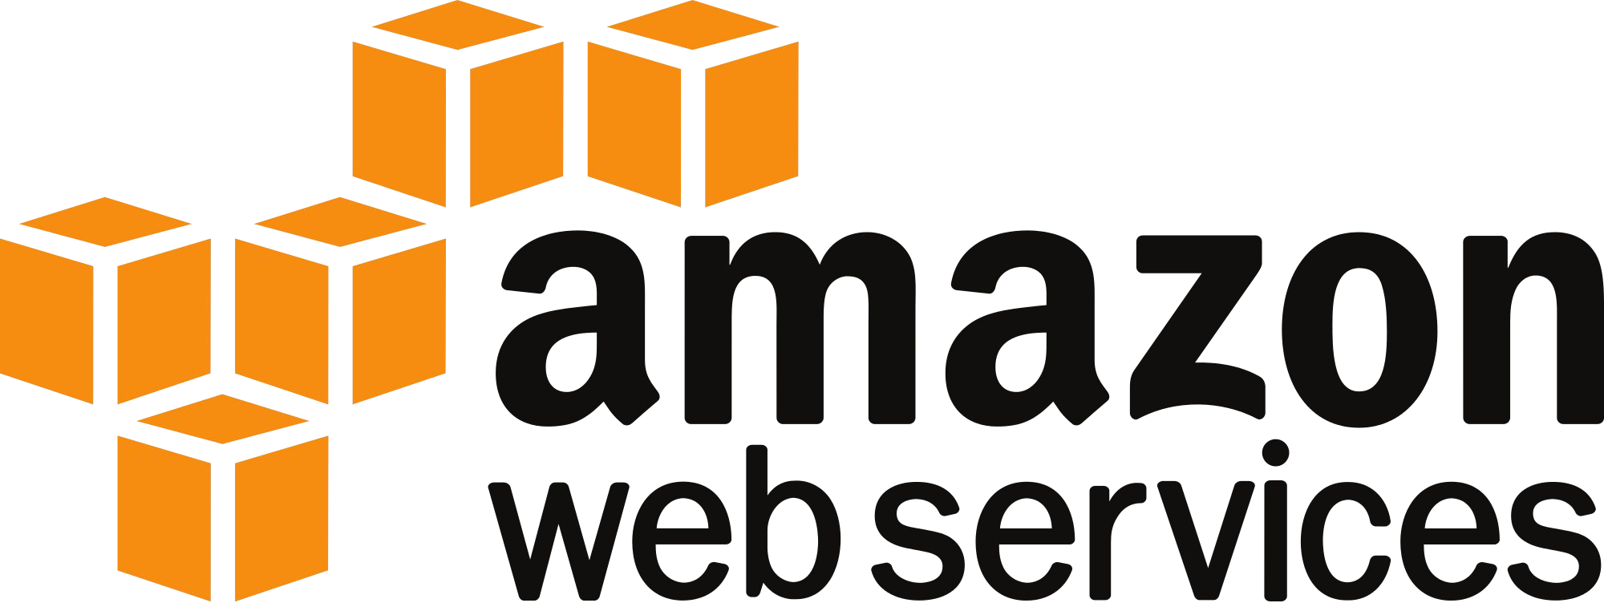
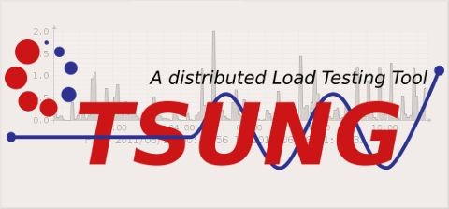
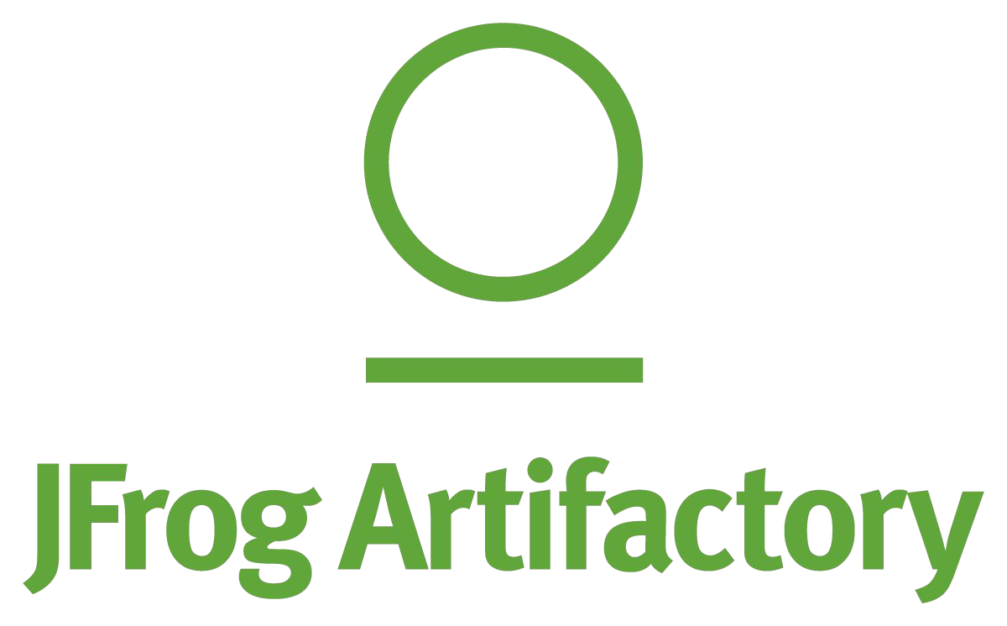

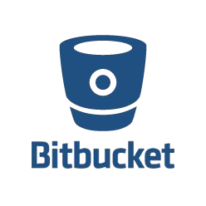

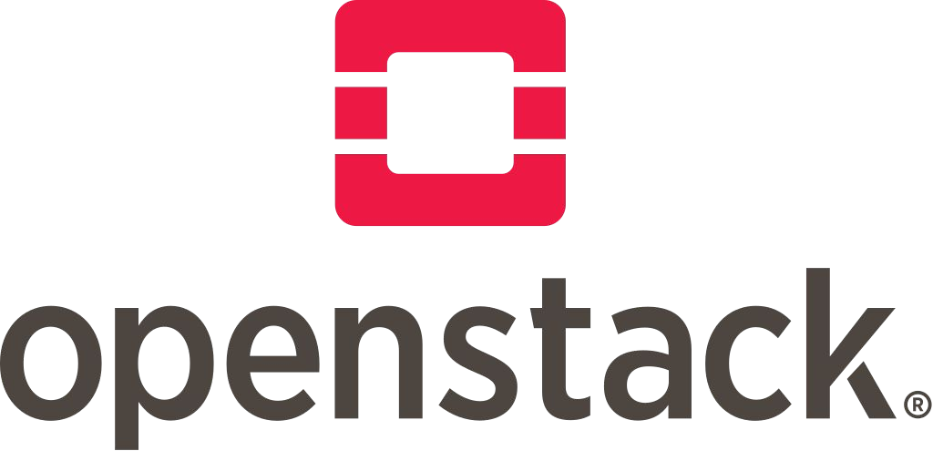
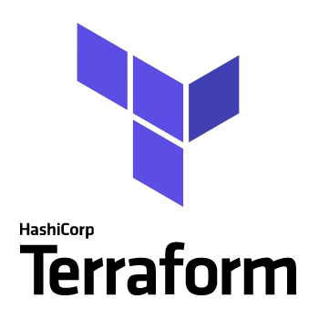

DevOps Technology
Version Control
CI/CD
Infrastructure as a Service
Infra Support

Slide 16
DevOps Flow
Artifacts
Dev
UAT
VCS
CI
CD
Developer
Prod
In practice, tools, methods, and technologies are seldom deployed on green-field sites and having implemented DevOps for more than a decade now, we believe that the key to successful implementation is to:
• Define a clear target
• Establish a clear transformation plan
• Actively manage the plan execution
Infrastructure
Monitoring
Load Testing

Slide 17

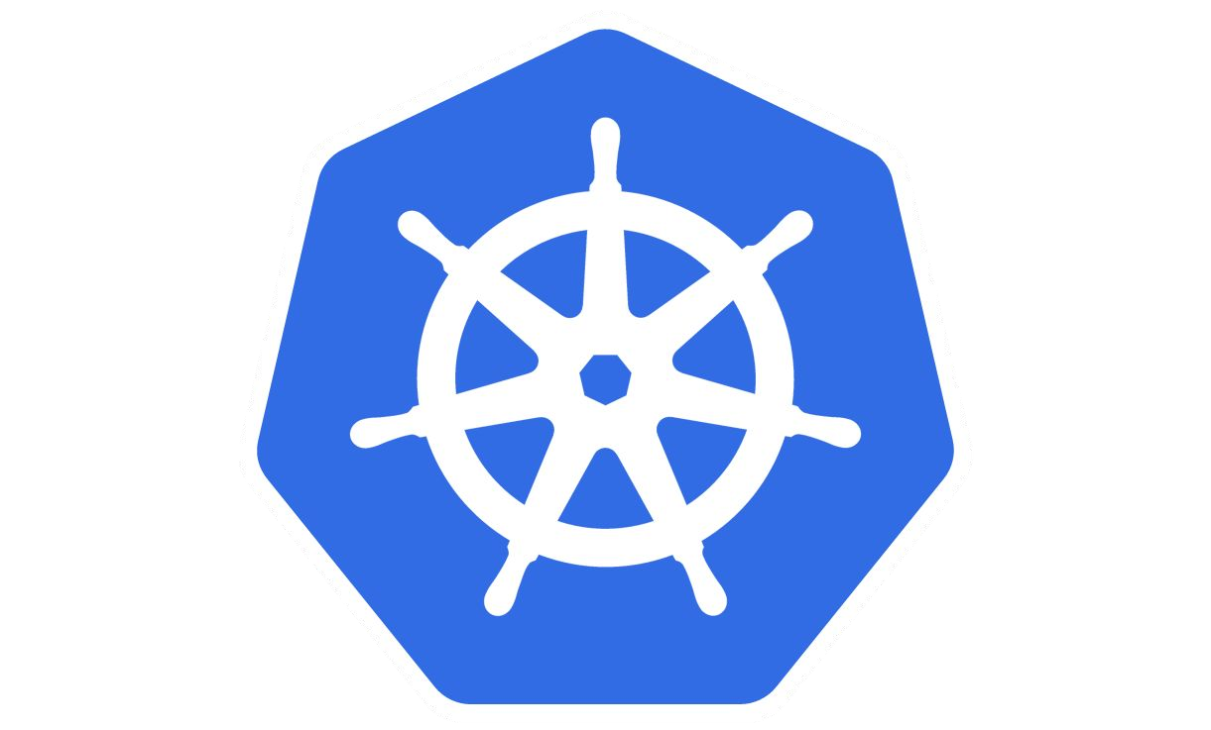

Devops Technology : Demo
Artifacts
Dev
UAT
VCS
CI
CD
Developer
Prod
Infrastructure
Monitoring
Load Testing

Slide 18
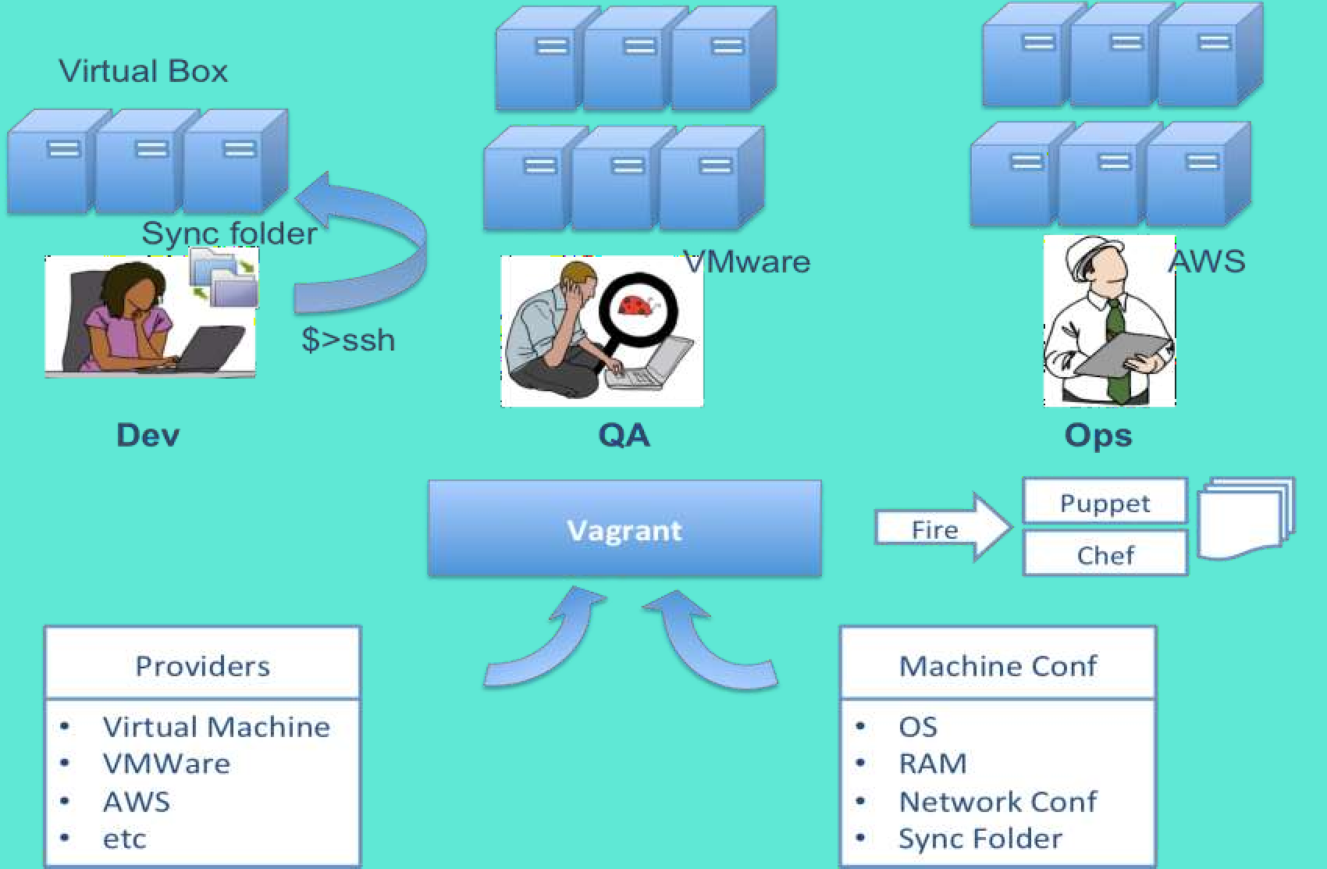
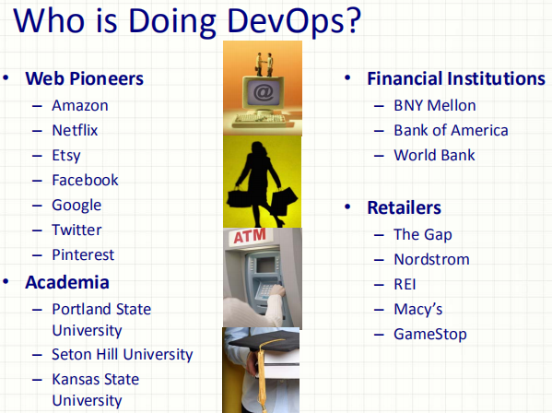
Application Usage Example
By 2019, over 70% of routine development-life cycle tasks will be automated, with an agile DevOps pipeline driving and incubating life cycle and application development intelligence.
With the overwhelming growth in the adoption of DevOps technology culture, it has been predicted that by the year 2021, more than 50% of the fortune companies would have the huge demand for DevOps certified professionals for the leading profiles like Delivery Heads and PMOs.

Slide 19
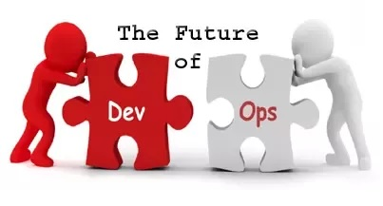
Future Scope
The future holds more focus on security and DevSecOps, using AI/ML to improve processes, and more automation. In modern world, this is the era of cloud and its related technologies.
In recent years there’s been a lot of discussion about cloud, and cloud storage, like AWS, Microsoft Azure, and Google Cloud as well as private and hybrid cloud.DevOps is becoming the standard way of working for businesses.
Last year, we have seen many industries adopted the solutions and practices that make up DevOps. According to a Capgemini report, 60% of companies have adopted DevOps or plan to do so in 2018.
▪DevSecOps with security tools and practices
▪DevOps into IoT
There is a huge demand for DevOps engineers and expert professionals as pioneer organizations have made a move to adopt the DevOps culture.
With DevOps certification mapped trainingYou can qualify for the following job roles:
•DevOps Architect •Software Tester •Security Engineer
•Integration Specialist •Release Manager •Automation Engineer

Slide 20
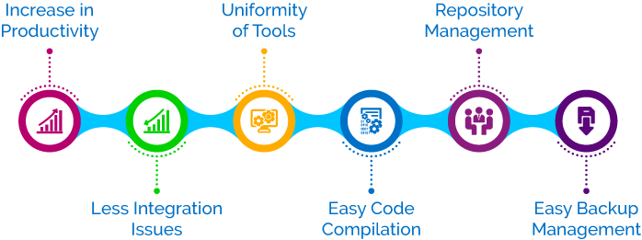
Key Trends in DevOps
Some of the key trends in DevOps are:
▪Many organizations recognized DevOps as the new ALM methodology.
▪Many DevOps/automation tools are being developed.
▪DevOps Engineers are paid highest pays in the market.
▪Ops professionals are getting their DevOps knowledge in production for testing and automation operations.
▪Automation and testing is gaining prominence in the market.

Slide 21
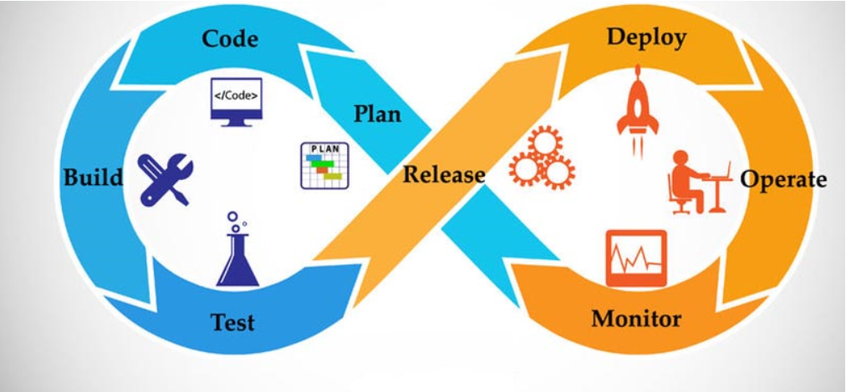
ADVANTAGES :The benefits of DevOps
Companies that incorporate DevOps practices get more done, plain and simple. DevOps organizations can deliver with maximum speed, functionality, and innovation.
DevOps is hot. This sizzling buzzword is on the tip of every tongue in the IT world, from Development, Testing and QA through IT Operations.
There are technical benefits:
•Continuous software delivery
•Less complexity to manage
•Faster resolution of problems
There are cultural benefits:
•Happier, more productive teams
•Higher employee engagement
•Greater professional development opportunities ,and
There are business benefits:
•Faster delivery of features
•More stable operating environments
•Improved communication and collaboration
•More time to innovate (rather than fix/maintain).

Slide 22
DevOps and its Challenges
DevOps and its challenges can be discussed from three perspectives: engineers, managers, and researchers. Engineers benefit from ,
(1) qualifying themselves for a DevOps position, a technically hard task guided by over 200 papers, 230 books, and 100 tools [63]. Engineers also need
(2) learn how to re-architect their systems to embrace continuous delivery. Managers want to know
(3) how to introduce DevOps into an organization
(4) how to assess the quality of already-adopted DevOps practices. Managers and engineers, also referred to as practitioners, share the necessity of choosing the best automation toolset. Finally, academic researchers
(5) conduct studies to determine the state of practice in DevOps, thereby contributing to discussions among engineers and managers, and
(6) educate a new generation of software engineers on DevOps principles and practices.

Slide 23
DevOps Limitations
Given the vast amount of work on DevOps, it was not feasible to conduct an exhaustive search in all available sources.
The first challenge your organization will encounter is a lack of thorough understanding of the key DevOps advantages and disadvantages.
Many definitions of DevOps have emerged, and it is important that an organization reach an agreement as to what their definition will be.
Before the beginning of your DevOps implementation project you’ll want to map out standards within your organization and optimize workflows.
Everyone’s roles will need to be redefined. New processes and new procedures will need to be developed, deployed, and training provided.
Communicating all of these changes across your entire organization is essential in ensuring that your DevOps initiative will be worthwhile and successful.
At all times remember that imperfect or half-baked DevOps can be far worse than no DevOps at all.

Slide 24
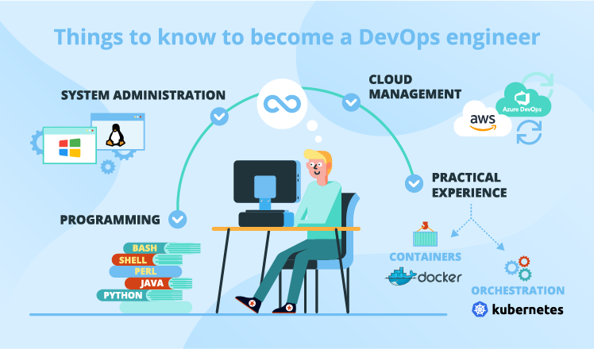
Conclusion
The future of DevOps is very promising, and many more companies are set to accept this methodology.
In fact, culture is very related to human factor.. As a result of the characterization process, we identified 13 attributes. The most frequently attributes in the 23 primary studies were 7:
(i) Communication, (ii) Collaboration, (iii) Feedback (Continuous and immediate),
(iv) Responsibility (personal/mutual), (v) Improvement cycle,
(vi) Sharing Knowledge, and (vii) Transparency.
DevOps will continue to be particularly essential as industries become more reliant on cloud infrastructure. In a 2017 report, Gartner Research projected that the Cloud Services market will grow over 15% per year through 2020.
To put this growth in terms of dollars, a recent article published by Forbes indicates that the cloud computing market will grow from roughly $260 billion in 2017 to roughly $411 billion in 2020.
DevOps can make a huge difference in how quickly your company successfully migrates systems onto the cloud.

Slide 25

References
[1]X. Bai, M. Li, D. Pei, S. Li, and D. Ye. 2018. Continuous Delivery of Personalized Assessment and Feedback in Agile Software Engineering Projects.
[2] Armin Balalaie, Abbas Heydarnoori, and Pooyan Jamshidi. 2016. Microservices Architecture Enables DevOps: Migration to a Cloud-Native Architecture. IEEE Software 33, 3 (2016), 42–52. Code: A2.
[3]Len Bass. 2018. The Software Architect and DevOps. IEEE Software 35, 1 (2018), 8–10. Code: I33.
[4]2017. xMatters Atlassian DevOps Maturity Survey Report 2017. (2017). https://www.xmatters.com/press-release/ xmatters-atlassian-2017-devops-maturity-survey-report/, accessed on Jun 2018. [52] 2018. How Netflix Thinks of DevOps. (2018).
[5]Capgemini, Technovision 2016, https://www.capgemini.com/blog/cto-blog/2015/11/technovision-2016-build-release-run-repeat Capgemini, TechnoVision 2015, http://www.capgemini.com/blog/cto-blog/2014/11/welcome-to-technovision-2015.
[6]Journal of Systems and Software. 123, 176–189 (2017). 6. Lwakatare, L.E., Kuvaja, P., Oivo, M.: Relationship of DevOps to Agile, Lean and Continuous Deployment. In: International Conference on Product-Focused Software Process Improvement. pp. 399–415. Springer (2016).

Slide 26


